Slide 1
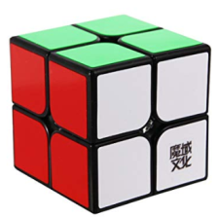
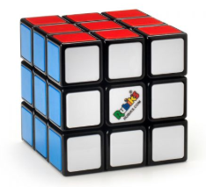
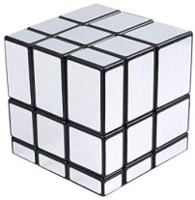
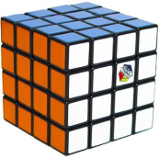
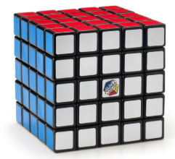
Recreational activity Unveils your Brains Interest Keeping you engaged
Entertainment Excitement Engagement
Rubik’s cube
Is it for Entertainment? Re creation? Relaxing? Rest?
Don’t worry it is for all of that.
Carry it anytime anywhere in any bag you want with ease
Learn how to solve ’em all .
Can start learning any time at any age.
Can help you increase your IQ and Logical reasoning.
Resisting you from boredom? Of course it can.
Oh wait it helps you with finger movements.
While moving the cube you can improve your reflex actions
by identifying the wrong turns while solving in speed.

